Slide 1
ABC Group of Hotels
The Battle of Neighbourhoods

Slide 2
Introduction
New York city review for ABC group of Hotels
Optimum location for new Restaurant business
Business Problem :
Choice of first neighborhood to start restaurant business.
Easy to replicate.
Low competition
High demand
Choice of Menu
Success Criteria :
- Best neighbourhood which meets above criteria.

Slide 3

Few Facts about New York City
Most populous city in the United States
It is diverse and is the financial capital of
USA
It is multicultural
Provides lot of business opportunities
Business friendly environment
Attracted many different players into the
market
Global hub of business and commerce.
The city is a major centre for banking and finance, retailing, world trade,transportation, tourism, real estate, new media, traditional media, advertising, legal services, accountancy, insurance, theatre, fashion, and the arts in the United States.

Slide 4
Business Environment of the NY City
• Market is highly competitive
• Highly developed city so cost of doing business is also costlier.
• New business venture or expansion needs to be analysed carefully
• One should strategically targeting the market in order to do :
-This will help in reduction of risk.
-The Return on Investment will be reasonable.

Slide 5
NY Cuisine Culture:
The City of New York is famous for its excellent cuisine. It's food culture includes an array of international cuisines influenced by the city's immigrant history.
Central and Eastern European immigrants, especially Jewish immigrants - bagels, cheesecake, hot dogs, knishes, and delicatessens
Italian immigrants - New York-style pizza and Italian cuisine
Jewish immigrants and Irish immigrants - pastrami and corned beef
Chinese and other Asian restaurants, sandwich joints, trattorias, diners, and coffeehouses are ubiquitous throughout the city
Mobile food vendors - Some 4,000 licensed by the city
Middle Eastern foods such as falafel and kebabs examples of modern New
York street food
Famous for fine dining Michelin starred restaurants. The city is home to "nearly one thousand of the finest and most diverse haute cuisine restaurants in the world", according to Michelin.
So it is evident that to survive in such competitive market it is very important to strategically plan.

Slide 6
NY Cuisine Culture:
• New York Population
• New York City Demographics
• Are there any Farmers Markets, Wholesale markets etc nearby so that the ingredients can be purchased fresh to maintain quality and cost?
• Are there any venues like Gyms, Entertainmnet zones, Parks etc nearby where floating population is high etc
• Who are the competitors in that location?
• Cuisine served / Menu of the competitors
• Segmentation of the Borough
• Untapped markets
• Saturated markets etc
The list can go on...

Slide 7
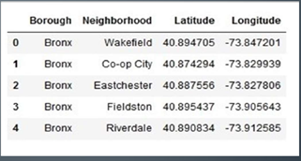
Data Description 1
Data 1 : Neighborhood has a total of 5 boroughs and 306 neighborhoods. In
order to segment the neighborhoods and explore them, we will essentially
need a dataset that contains the 5 boroughs and the neighborhoods that
exist in each borough as well as the latitude and longitude coordinates of
each neighborhood.
• This dataset exists for free on the web. Link to the dataset is :
https://geo.nyu.edu/catalog/nyu_2451_34572

Slide 8
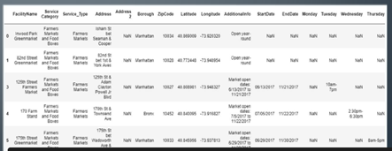
Data Description 2
• Data 2 : Farmers Markets data
• https://data.cityofnewyork.us/dataset/DOHMH-Farmers-Markets-and-Food-Boxes/8vwk-6iz2
• A farmers' market is often defined as a public site used by two or more local or regional producers for the direct sale of farm products to consumers. In addition to fresh fruits and vegetables, markets may sell dairy products, fish, meat, baked goods, and other minimally processed foods.

Slide 9
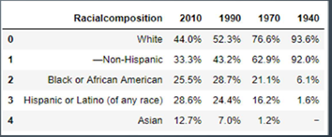
Data Description 3
Data 3 : Data from Wikipedia pages as given below :
• New York Population
• New York City Demographics
• Cuisine of New York city
https://en.wikipedia.org/wiki/New_York_City
https://en.wikipedia.org/wiki/Economy_of_New_York_City
https://en.wikipedia.org/wiki/Portal:New_York_City
https://en.wikipedia.org/wiki/Cuisine_of_New_York_City

Slide 10
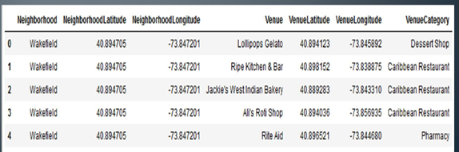
Data Description 4
Data from foursquare.com
Newyork city geographical coordinates data will be utilized as input for the Foursquare API, that will be leveraged to provision venues information for each
neighborhood.We will use the Foursquare API to explore neighborhoods in New York City. The below is image of the Foursquare API

Slide 11
Analytic Approach
New York city neighborhood has a total of 5 boroughs and306 neighborhoods
PART 1 - Clustering of Manhattan and Brooklyn
PART 2 - Clustering of Bronx, Queens and Staten Island.
Only restaurant data is filtered from foursquare.com venues data and utilized for this project.
This is done because of the following Exploratory data analysis.

Slide 12
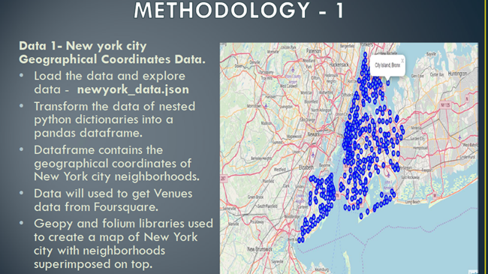

Slide 13
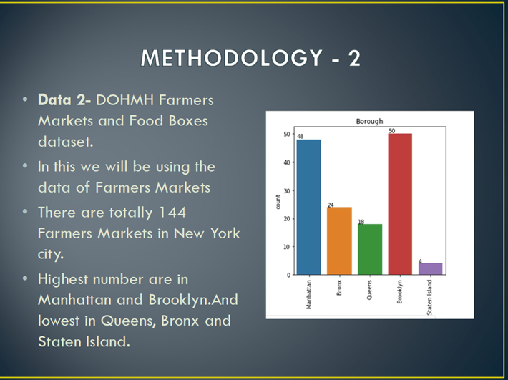

Slide 14
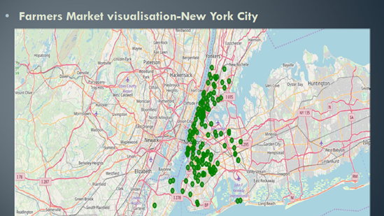

Slide 15

Methodology 3
Data 3 : To analyize New York city Population, Demographics and Cuisine , scrapped the data from Wikipedia pages given above in the data section.
We used BeautifulSoup python library.
Beautiful Soup is a Python package for parsing HTML and XML documents (including having malformed markup, i.e. non-closed tags, so named after tag soup).
It creates a parse tree for parsed pages that can be used to extract data from HTML, which is useful for web scraping

Slide 16
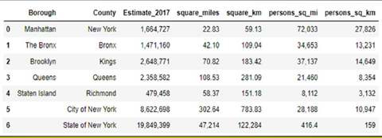
Methodology 3 New York Population
Manhattan (New York County) is the geographically smallest and most densely populated borough.
• Manhattan's (New York County's) population density of 72,033 people per square mile (27,812/km²) in 2015 makes it the highest of any county in the United States and higher than the density of any individual American city.
• Brooklyn (Kings County), on the western tip of Long Island, is the city's most populous borough.
• Queens (Queens County), on Long Island north and east of Brooklyn, is geographically the largest borough.

Slide 17
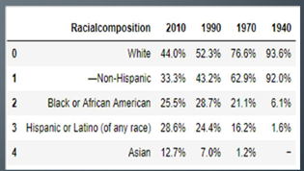
Methodology -3 New York City Demographics
• New York City is the most populous city in the United States , with an
estimated record high of 8,622,698 residents as of 2017,incorporating more immigration into the city than outmigration since the 2010 United States Census.
• The racial composition is as given below. This is the reason New York city has restaurants serving cuisine from many countries such as India, Africa, Japan etc. This also increases the scope for restaurants business in New York City.

Slide 18
Methodology 4 Foursquare.com
• NewYork city geographical coordinates data has be utilized as input for the Foursquare API, that has been leveraged to provision venues information for each neighborhood.
• We used the Foursquare API data to explore neighborhoods in New York City.
• Using the geographical coordinates of each neighbourhood
Foursquare API calls are made to get top 200 venues in a radius of 1000 meters
PART – 1 Brooklyn and Manhattan
PART – 2 Bronx, Queens and Staten Island

Slide 19
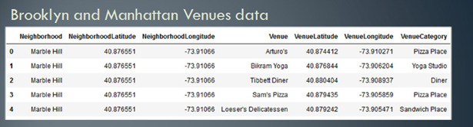
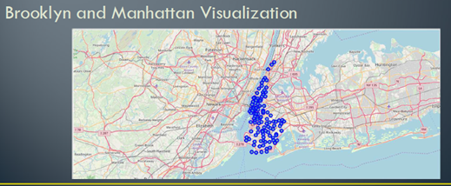
Methodology 4 Part -1 Broklyn and Manhattan

Slide 20
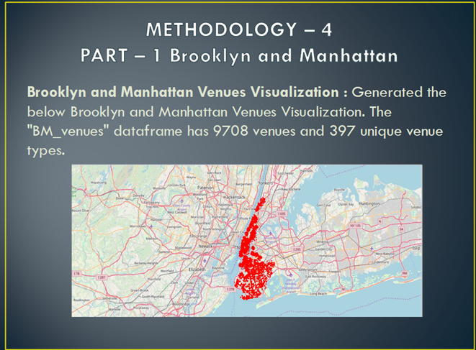

Slide 21
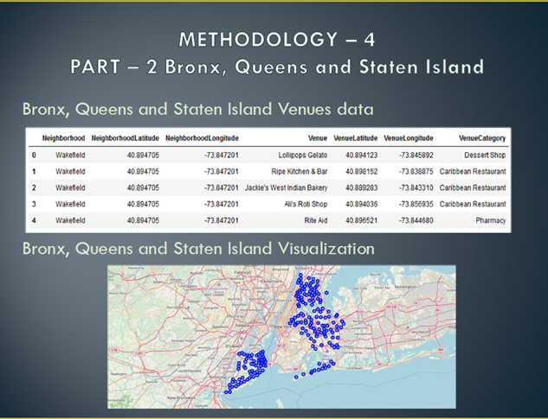

Slide 22
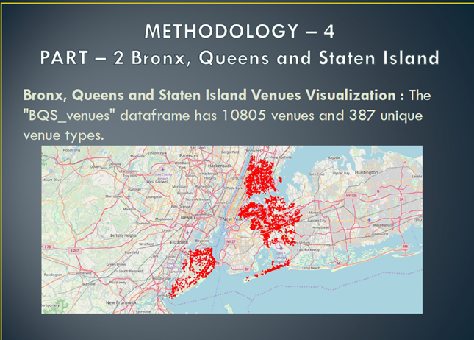

Slide 23
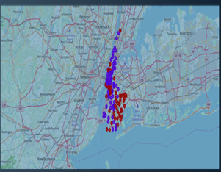
Result Part-1 Brooklyn and Manhattan
Segmenting and Clustering
Neighborhoods
Cluster0 : The Total and Total Sum of cluster0 has smallest value. It shows that the market is not saturated.
Cluster1 : The Total and Total Sum is very high. Lot of competition. Saturated neighborhoods.

Slide 24
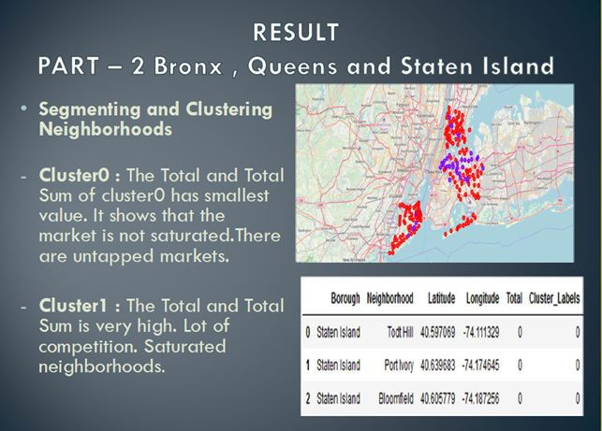

Slide 25
Discussion
• Scope to explore cuisines of various countries in Bronx, Queens and Staten Island
In Manhattan and Brooklyn restaurants , cuisines of many countries are part of their
Menu. Risk can be taken with great menu on board. It also shows people love and explore cuisines of various countries.
• Scope to increase Farmers markets in Bronx, Queens and Staten Island.
- Region - Cluster0
- Neighborhood – Staten Island – Tod Hill, Port Ivory, Bloomfield

Slide 26
Conclusion
Analysis performed on limited data
• Re-run program with updated information
• Brooklyn and Manhattan has high concentration of restaurant business. Very competitive market.
• Bronx, Queens and Staten Island also has good number of restaurants but not as many as required. So this can be explored.
• As per the neighbourhood or restaurant type mentioned like Indian Restaurant, analysis can be checked. A venue with lowest risk and competition can be identified

